Slide 1
Requirements Specification
Your excellent software begins here.

Slide 2
Software Development Stages
Requirements Engineering
Designing
Implementation
Testing and Verification
Maintenance

Slide 3
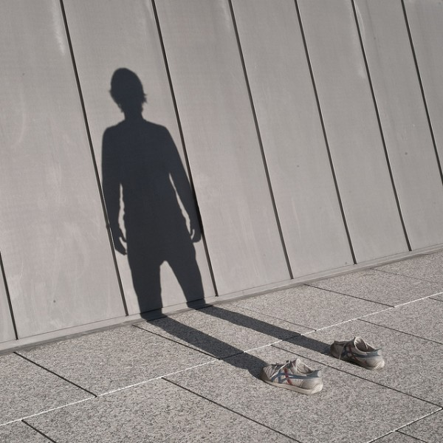
Recall: Software Invisibility

Slide 4


Worst Case Scenario
But..
I did
my best
Not happy
Client
Developer
at the end of project

Slide 5
The problem
No vivid, tangible model of the system
The effect
Users can’t imagine what the system will do for them.
How to verify
EARLY in the project?
Notes:
Gane and Sarson observed, “We have no way of showing vivid tangible model of the system to the users. It’s hard for users to imagine what the new system is going to do for them until it is actually in operation, by which time it’s usually too late.”

Slide 6
Over the past terms…
How did your Machine Projects specification look like?
Database Application
Simple Games
Algorithms
And so on…

Slide 7
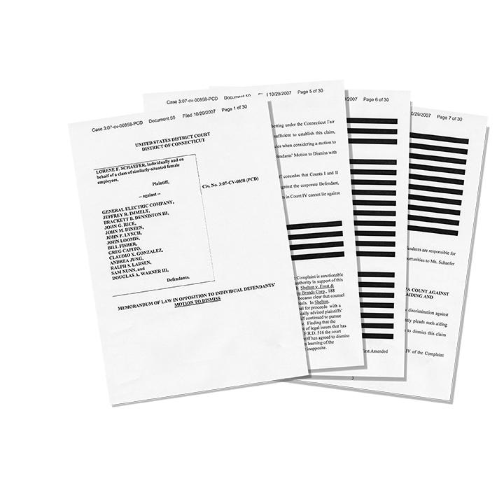

How are features described in your machine project specs?

Slide 8
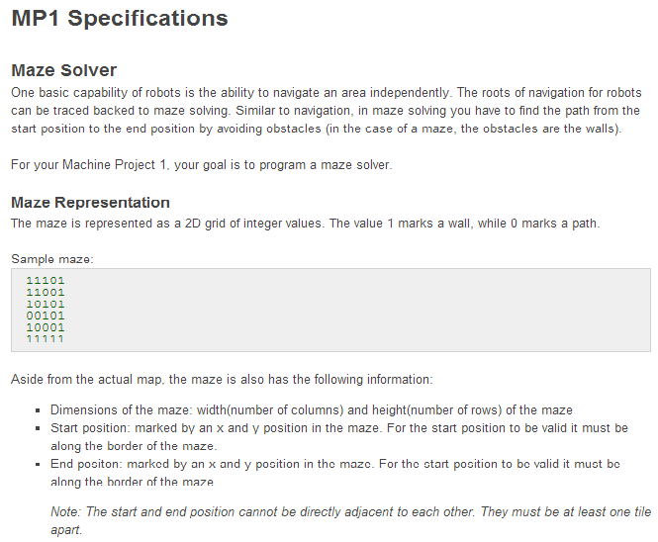
Something like this?

Slide 9
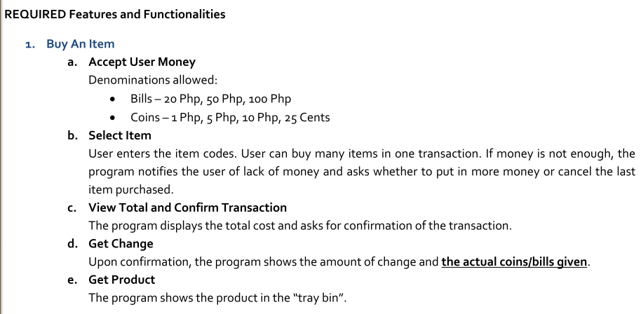
Usually had something like this….

Slide 10
What “model” can we use to help the user and developer UNDERSTAND the ff:?
The goal of the requirement
The interaction between the user and system
How to know if the requirement is “done” (acceptance criteria)?

Slide 11
Example Software Project
C+ Company provides online programming tutoring service to foreign students.
Students can view teacher’s profile and schedule and reserve their classes.
Each class will last for 25 minutes with a 5 min break in between.
Teacher submit their weekly schedule and open classes from 5am to 12mn.

Slide 12
1 - Start with a User story
Role of User
Goal/Task
Teacher can submit their schedule to
open their classes for reservation.
10
Tangible benefit and value of the feature
Priority
This should be done
with the Clients!

Slide 13
2 - Describe the interaction
How will the user USE the system to accomplish the particular goal/task?
System displays the weekly schedule form with the relevant days/dates.
Teacher selects which classes to open for the week.
System validates the schedule’s compliance to company rules.
System displays a preview of the weekly schedule.
System asks if the schedule details are correct and final.
Teacher confirms that the submitted schedule is correct and final.
System informs the teacher that the weekly schedule has been updated.

Slide 14
2- Describe the interaction
Provide a context for the interaction
Precondition: Teacher is a registered user.
Provide a way to verify that the interaction has been completed.
Post-conditions: System saves the schedule. Student can view the newly opened classes from that teacher.

Slide 15
3 - Define the Acceptance Criteria
Think of alternatives or exceptions that must be checked.
Test that schedule has a minimum of 50 classes.
Test that at least 30 classes were opened at peak times.
Test that the system shows the correct validation message and allows the teacher to fix the schedule.
Test that the schedule shows the correct dates/days for the week.
Test that schedule information is saved in the database.
Test that the updated schedule is viewed correctly by students.

Slide 16
What about sample screens?
Interface design should be based on REQUIREMENTS.
Sample screens may shift the focus on HOW instead of WHAT the software will do.

Slide 17
Try it for yourself:
Write the specifications for the Student’s Reservation of Classes.
Step 1: Start with the story.
Step 2: Describe the interaction.
Step 3: Define the acceptance criteria.

Slide 18
Try it for yourself:
CHALLENGE: Use only 1/2 sheet.
Front Page : User story
Front Page : Interaction
Back Page : Acceptance Criteria

Slide 19
That wasn’t so hard was it? ☺
… that’s the easy part >.<

Slide 20

Next Step: Verifying
Requirements

Slide 21
Ambiguity Problem

Slide 22
Ambiguous
How do you interpret this requirement:
User can view the weather for the next 24 hours.
Show the current weather for the next 24 hours
Show the projected weather for the forthcoming 24 hours
or
What can happen if the client and developers interpret this differently?

Slide 23
Ambiguous (more like Vague)
Example #2:
Shut off the pumps if the water level remains above 100 meters for 4 seconds.
Mean water level?
Standard interpretation
Root mean square water level?
Median water level?
Minimum water level?
Software engineers assumed this!

Slide 24

Ambiguous
Difficult to detect
Requires special DOMAIN understanding or knowledge

Slide 25
Low-Value Problem
Aka
Gold-Plating,
Feature Creep

Slide 26

Low-Value / Unnecessary
I’ve thought of a neat feature! I’m sure the client will like this.
Unrequested!

Slide 27

Low-Value / Unnecessary
… Only to find out that the feature is NOT BEING USED at all.

Slide 28
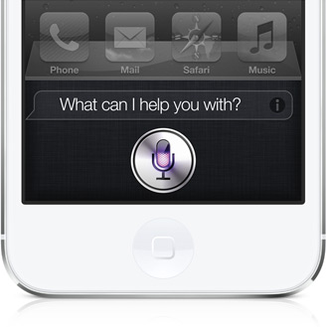
Low-Value / Unnecessary
Example #1:
Siri – Apple users, how often do you use this feature?

Slide 29
Low-Value / Unnecessary
Example #2:
Nero – used to be a program for burning CDs/DVDs
But when you install it you now find it has video editing, cover designer, audio improvement, etc.

Slide 30
Low-Value / Unnecessary
Increases work load (design, develop and test) and costs
Increases the customer’s expectations! – What if you can’t meet them anymore?

Slide 31
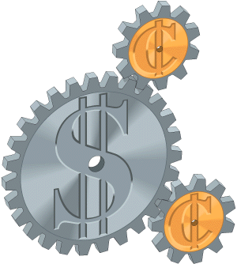
Low-Value/Unnecessary
How to know if your requirement is valuable?
It clearly solves a problem.
It supports a business strategy.
It improves their tasks/work.
It meets client’s criteria.

Slide 32
Low-Value/Unnecessary
WARNING
Just because it’s not in the requirements – it means it’s not necessary!

Slide 33
Incomplete Problem

Slide 34
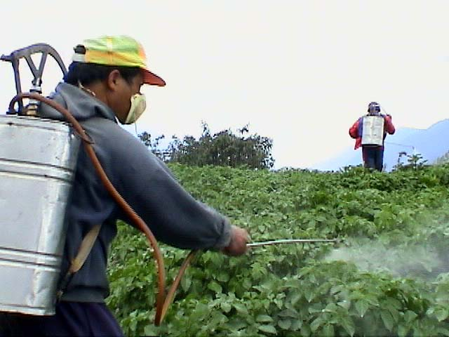
Incomplete
Example #1 Market Problem
Not enough money from treatments
But prices are competitive and costs are in line.
Technicians are fully booked.

Slide 35
Incomplete
Example #1 Market Problem
3 hrs/day spent driving from job to job – DOUBLE the industry standard.
Travel time could be reduced by 70% if treatments are reorganized.

Slide 36
Incomplete
Example #1 Sample Requirement
System determines better routes for our technicians each day.
Optimum route means minimum travel time between each location and between office and first location.

Slide 37
Incomplete
Example #1 Sample Requirement
Acceptance Criteria:
routes must be 50% better than existing process

Slide 38
Incomplete
Example #1 Analysis
80% of the time, the technicians have to return to pick up more treatment.
Or if they have left-overs, they cancel last job of the day to return to the office.

Slide 39
Incomplete
Example #1 What is missing?
The system must also plan the amount of chemicals to take each day!

Slide 40
Incomplete
Example #2
Details can be both an advantage and
a disadvantage.
Pilot disengages the auto-pilot by applying enough force. System responds by releasing controls of ailerons, elevators and rudder.
Actual Case: Aeroflot 593
http://www.youtube.com/watch?v=-br5yJqsH4c

Slide 41
Other Problems

Slide 42
Other problems
Unverifiable
Makes it difficult to communicate to the team what they need to accomplish.
Inconsistent
Grammatically confusing
Logically inconsistent leading to conflicting requirements
Impossible

Slide 43
Check your understanding
Reflection (Individual)
Review past machine project specifications. Find any features/functionalities that were problematic ☺
For future projects, learn to be critical of the requirements!

Slide 44
Assignment: [ALL]
Watch the video on Estimation

Slide 45
Assignment: [ALL except ANA]

Slide 46
Assignment: [ANA]

Slide 47
Assignment: [DEV]

Slide 48
References
http://www.agilemodeling.com/artifacts/userStory.htm
http://www.extremeprogramming.org/rules/userstories.html
http://www.xpexchange.net/en/intro/userStory.html
http://services.natureserve.org/member/userStory.htm
http://tynerblain.com/blog/2006/05/25/writing-good-requirements-the-big-ten-rules/
D. Pilone and R. Miles: Head First Software Development.O’Reilly, 2008

